Slide 1


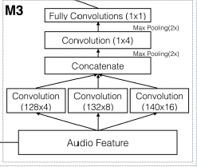
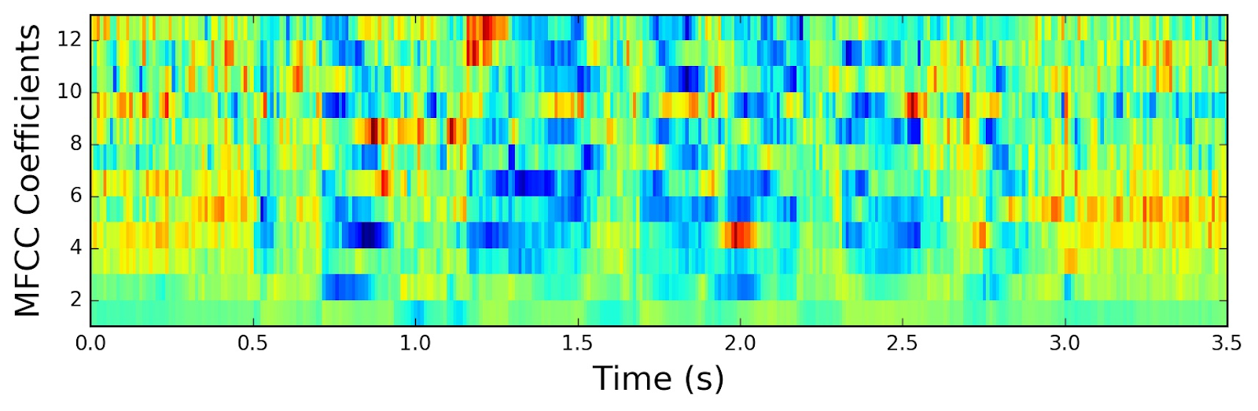
SO YOU THINK YOU CAN DANCE?
Andrew Kopplin, Lynn Hlaing, Marshall Vyletel
Intro:
The problem we tried to address in this project is the issue of classifying the danceability of songs. Our model attempts to solve this problem by using a deep convolutional neural network on the song’s timbre as MFCC-like features to predict whether a song is danceable or not. This “danceability” rating was created and calculated by The Echo Nest, a music analytics/”intelligence” company, and is accessible on the whole Spotify library using the Spotify API. Our hope is that when empowered with this algorithm, “aux holders” can more easily scrub their potential party playlists for undanceable songs, leaving the world a more dance-filled place.
Data:
The Dataset:
Our dataset for this project was the Million Song Dataset. It is described as “a collection of audio features and metadata for a million contemporary, popular music tracks. It is filled with attributes such as: energy, key, similar artists, hotness, and timbre, which is what we used to attempt to predict the danceability. The entire dataset is 280 GB. Due to memory constraints we could not use the complete dataset and instead used a pre-chosen subset of 10,000 songs. This dataset was a collaborative project between The Echo Nest and LabROSA (Laboratory for the Recognition and Organization of Speech and Audio) at Columbia University. The following paper addresses the creation of the dataset:
Thierry Bertin-Mahieux, Daniel P.W. Ellis, Brian Whitman, and Paul Lamere. The Million Song Dataset. In Proceedings of the 12th International Society for Music Information Retrieval Conference (ISMIR 2011), 2011.
The Data:
To attempt to predict the danceability of a song, we decided to use song timbre. This is a musical term that is defined as “the character or quality of a musical sound or voice as distinct from its pitch and intensity”. This timbre data was calculated by The Echo Nest as part of the Million Song Dataset. It attempts to capture the songs timbre as 12 MFCC-like features.
Mel Frequency Cepstral Coefficient (MFCC) is an audio analysis technique that is commonly used in speech processing to approximate sound data through a small set of output features. The goal of this method is to interpret the audio data in a similar way to how the human ear does. This feature extraction is similar to process of extracting object seams in typical image convolution. To turn an audio signal into its MFCC features, the following steps are followed. First, the signal is split into time segments. Then, a discrete Fourier transform is applied to extract frequency information. Then, the Mel scale is applied. This is the critical scale in making the analysis seem more human like. Loudness appears to changes according to frequency in humans (think about how a really high-pitched sound doesn't sound that loud). The Mel scale attempts to map the true frequency to the more accurate perceived human one. Next, the log of this output is taken, followed by a discrete cosine transform. The result is a small set of features for each segment (in this case 12) that attempts to more accurately model the timbre of the song. A visualization of this technique can be observed to the below.
Architecture :
Our architecture follows the one used in method three of the paper “Revisiting the problem of audio-based hit song prediction using convolutional neural networks” by Yang et al. (2017). However, instead of generating popularity predictions we adapted the model to output our danceability prediction. This model similarly uses MFCC input features as input audio data. The architecture is visualized out to the right.
One critical portion of the architecture is the inception module that is used as the first layer of the network. The idea of inception was first introduced in GoogLeNet. The idea behind utilizing simultaneous convolutional layers in a convolutional classifier is to pull a greater number of important features from an image where each feature may significantly differ in its size. When only one convolutional layer is used, some of the information may be lost because it is held in a region that is not adequately analyzed by the single kernel size. By adding multiple convolutional layers with different sized kernels the neural net can analyze a greater variation of features from the input image. By combining all these layers at the end of the inception module, the rest of the neural network can better analyze a greater feature set, leading to a deeper network.
Results :
https://haythamfayek.com/2016/04/21/speech-processing-for-machine-learning.html
Discussion:
This project implementation was very simple due to limitations in data size and design time constraints. Some future developments could be beneficial to create a more functional network. One possible improvement is turning the network from a classifier into a danceability predictor that outputs an estimation of the actual danceability metric instead of just a binary danceability classification. This function would learn what features make a song danceable, so passing those features into a generator network that created “danceable” songs would be a great way to observe the results.

